Slide 1
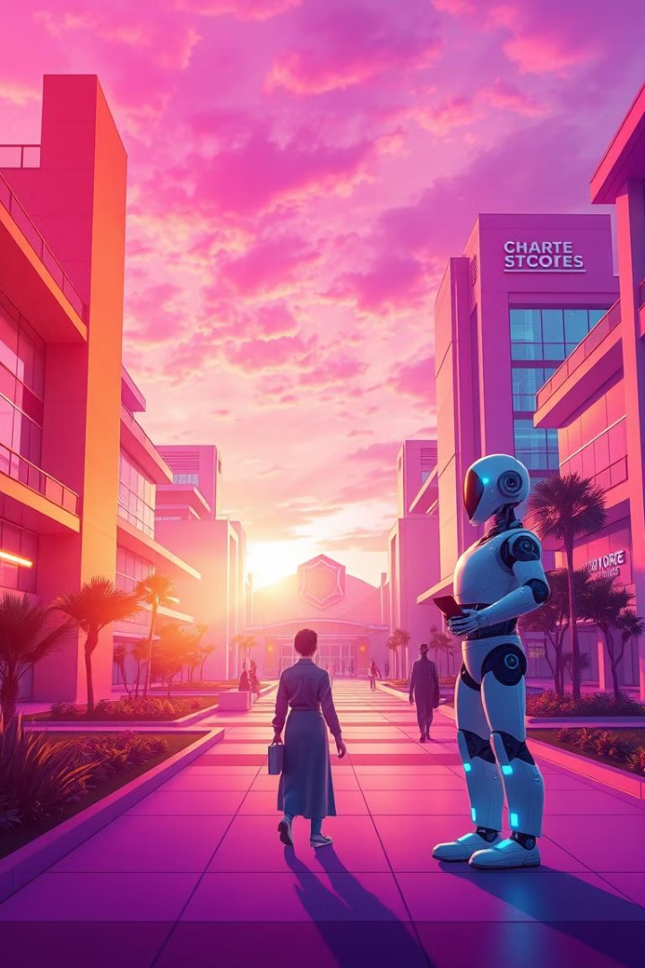
# CampusBot OS: A Smart Campus Operating System for Any Robot
This is a hardware-agnostic AI software designed for any college robot or embedded system. Built for the NextQuantum 2.0 Hackathon, this solution transforms ordinary robots into intelligent smart-campus assistants — without building any new hardware. CampusBot OS aims to provide intelligent, adaptable solutions for the next generation of smart campuses, starting with voice-based interaction and multilingual support.

Slide 2
# The Problem: Dumb Robots on Campus
Current campus robots are often limited in their capabilities, lacking the intelligence and adaptability needed for effective interaction. Their basic navigation and simple task execution fall short of delivering a truly enhanced student experience. The high development costs associated with custom robot solutions further exacerbate the problem, leaving a missed opportunity for creating truly intelligent smart-campus assistants. These robots are essentially "dumb," needing significant upgrades.

Slide 3

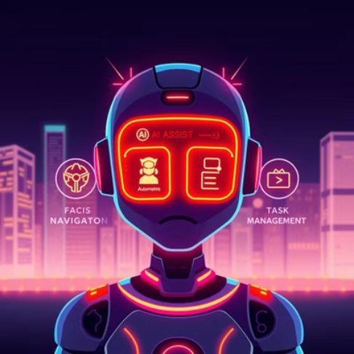
# Our Solution: CampusBot OS
Motto : To build the nation's future

Slide 4
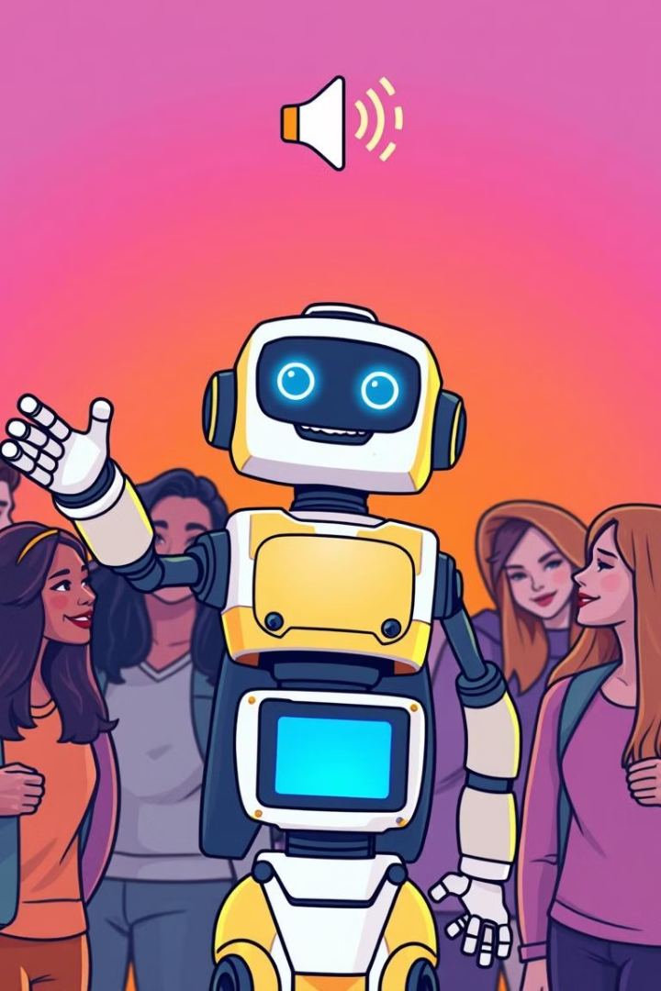
# Key Features: Voice Announcements & Multilingual Chat
Voice-Based Daily Announcements: Customizable schedule for delivering important college announcements. Human-Like Multilingual Conversation: Supports English, Spanish, and Mandarin for broad accessibility. Real-Time Q&A: Provides instant answers for students and faculty inquiries. Seamless Integration: Connects with campus information systems via API.

Slide 5
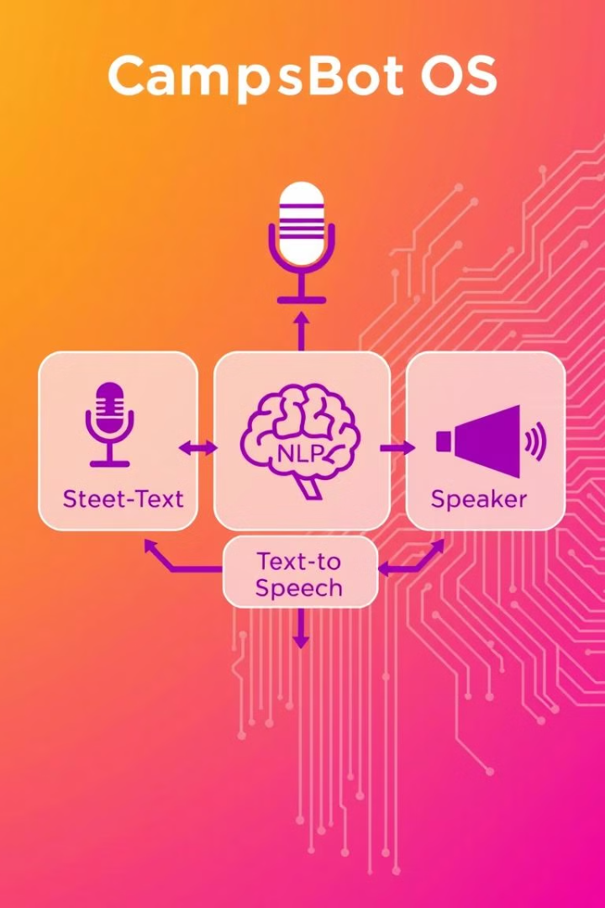
# Technical Deep Dive: AI Architecture
The core AI models driving CampusBot OS include Speech-to-Text, NLP (Natural Language Processing), and Text-to-Speech. It leverages cloud-based AI services from Google, AWS, and Azure for scalability and performance. The architecture is optimized for low-latency response and high accuracy in speech recognition and natural language understanding. A modular design allows for easy feature expansion and customization to meet specific campus needs.

Slide 6
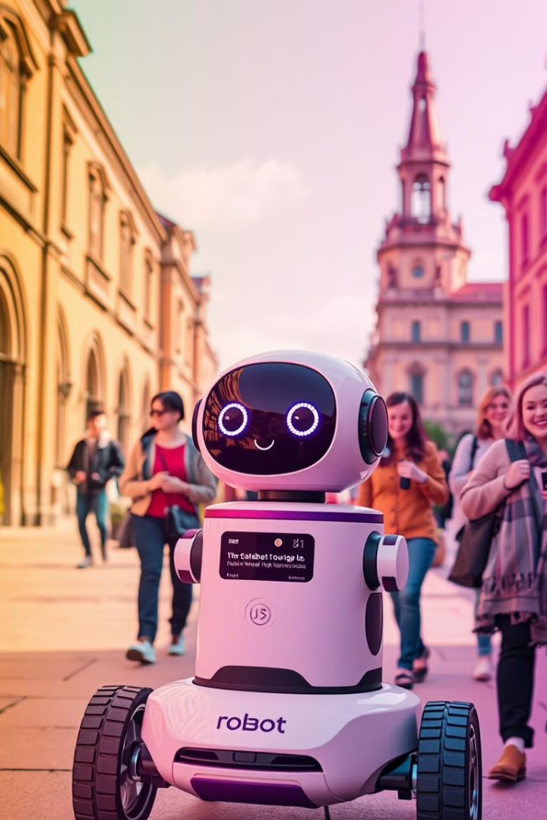
# Use Case: Robot Tour Guide
Imagine a campus tour robot enhanced by CampusBot OS. The robot guides visitors with voice-based information presented in multiple languages, offering a personalized and informative experience. It answers questions about campus history, landmarks, and upcoming events in real-time. User feedback is collected to continually improve the tour experience. It elevates simple tours to a richer, more engaging level for all visitors.

Slide 7
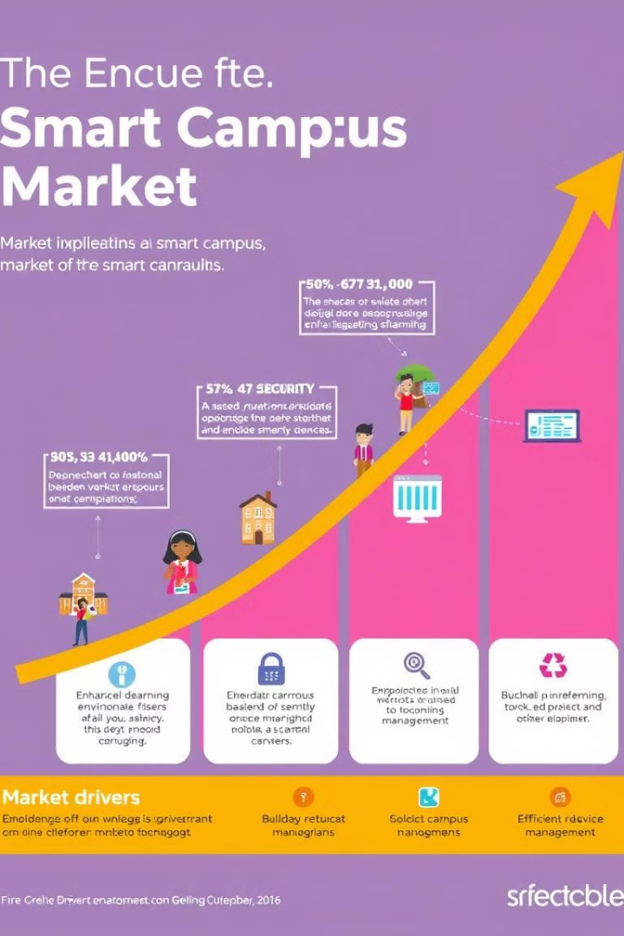
# Market Opportunity: Smart Campus Solutions
1
The smart campus market is projected to reach $46B by 2028, with a CAGR of 18.5%. Our target market encompasses over 4,000 colleges and universities in the US, presenting a significant opportunity for CampusBot OS. Potential revenue streams include licensing the OS to robot manufacturers and expanding applications to hospitals, offices, and other smart environments. This represents a vast, untapped opportunity.

Slide 8
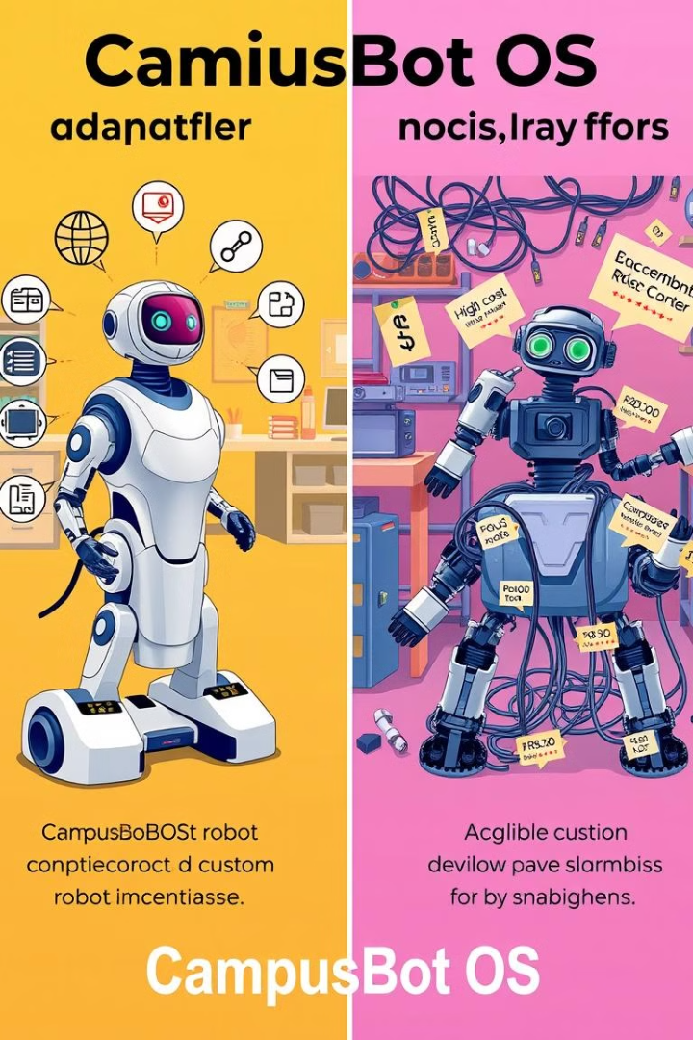
# Competitive Advantage
Hardware-Agnostic Design: Lowers the barrier to entry and reduces integration costs. AI-Powered Features: Enhances robot capabilities and provides intelligent interactions. Scalable Architecture: Supports growing campus needs and increasing robot deployments. Cost-Effective Solution: Reduces overall costs compared to custom robot development.

Slide 9
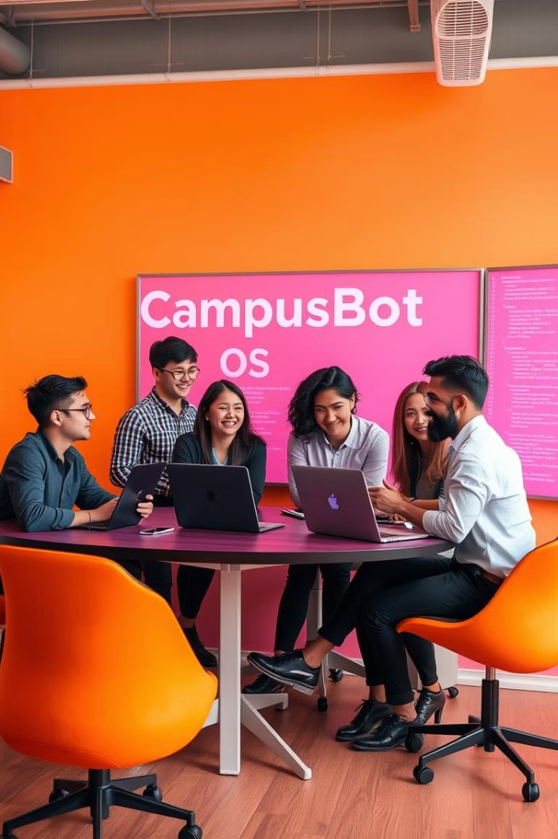
# The Team
Our team comprises experienced developers, AI engineers, and campus technology experts with a proven track record in software development and robotics. We are passionate about transforming the campus experience through innovative solutions. We are actively seeking strategic partners and advisors to help us scale and realize our vision. Our expertise and passion drive us forward.

Slide 10

# Call to Action: Partner with CampusBot OS
We are seeking seed funding to scale development and deployment of CampusBot OS. We invite you to explore pilot programs with select universities and colleges. Contact us today to discuss partnership opportunities and invest in the future of smart campus technology. Together, we can revolutionize the campus experience. Let's build the future, together.

